Slide 1


Unit - 1
Green skilling and Sustainability

Slide 2
Chapters for Discussion
Chapter - 1
Foundation of Green Skilling, Sustainability and AI Contributions

Slide 3

Foundation of Green Skilling, Sustainability and AI Contributions
Unit
1

Slide 4


DISCLAIMER
The content is curated from online/offline resources and used for educational purpose only.

Slide 5

Learning Objectives
By the end of this presentation, participants will be able to:
Understand the role of green skills in supporting sustainable economies and tackling environmental challenges.
Explain key environmental concepts like ecological and carbon footprints, and ways to reduce them.
Analyze strategies for promoting environmental literacy, sustainable practices, and resource management.
Recognize the role of governments, institutions, and global agreements (e.g., Paris Agreement, SDGs) in sustainability efforts.
Apply sustainable practices in daily life and business, such as waste reduction and energy conservation.
GOAL
Source :
www.freepik.com/

Slide 6

Environmental Awareness and Literacy
Environmental literacy is the ability to know and act toward the solution of environmental problems.
Environmental literacy is key to understanding and addressing environmental issues.
Importance of Environmental Awareness
Informed Decision-Making
Environmental literacy helps individuals make informed choices.
Sense of Responsibility
It fosters a sense of responsibility toward nature.
Empowerment for Action
An environmentally literate society is better prepared to advocate for environmental protection.
Enhanced Quality of Life
A healthy environment enhances quality of life.
Source :
https://www.freepik.com/photos/environmental-literacy
Notes:
Introduction
There are various challenges the world is facing concerning the environment, such as climate change and resource depletion. Green skills therefore play a vital role in the realization of green economies. Green skills refer to the know-how and skills that can support sustainable, low-carbon economies. Such skills are essential in many areas such as energy, agriculture, to name but a few, which play a crucial role in enabling persons and organizations build a better environment.
This chapter discuses the important issues on green skilling on areas such as environmental awareness, sustainable practices, green technologies, and the increase in the demand for green jobs. Governments, education, and training also fall under discussion to achieve a bright, sustainable future for all.
Environmental Awareness and Literacy
This is brought through environmental awareness and literacy, which helps the public and business entities realize their connectivity to the environment, understand the important issues, and make effective strides that reflect lifestyle of sustainability. This section covers definition, importance, core elements, and strategies in improving environmental literacy, and all of it just takes shape with the help of key concepts such as ecological footprint, carbon footprint, education.
Environmental literacy is the ability to know and act toward the solution of environmental problems. It encompasses a corpus of knowledge of natural systems, environmental issues, and their solutions as well as skills and motivation to undertake civic and environmental actions. The UN underlines the importance of environmental literacy for sustainable development and for involving people in solving the problems which affect the environment.
Importance of Environmental Awareness
Informed Decision-Making
Environmental literacy empowers an individual to make better decisions that impact their personal lives and communities. For example, knowledge about carbon footprints inspires one to embrace public transportation, renewable energy, and other sustainable practices.
Sense of Responsibility
Environmental awareness gives a sense of responsibility towards nature. It shows people the value of biodiversity and one's role in conservation by creating proactive behaviors such as conservation and resource management.
Empowerment for Action
A literate public on the environment is better positioned to advocate for its protection through policy measures, activism, and conservation practices at the grass roots level.
Enhanced Quality of Life
A relationship with nature is believed to positively impact mental health and overall well being. A healthy environment is conducive to the quality of life, which underscores protection of the natural ecosystems through sustainable practices.

Slide 7
Ecological Footprint and Carbon Footprint Education
Ecological and carbon footprints are key to understanding measurable consumption impacts on natural resources and the environment for individuals and companies.
Ecological Footprint
Quantifies the amount of resources needed to support our lifestyle.
Carbon Footprint
Measures the total amount of greenhouse gases emitted.
Reducing the ecological footprint involves adopting sustainable consumption habits
Strategies for reduction include using renewable energy and reducing energy consumption
Source :
www.freepik.com/
Notes:
Ecological Footprint and Carbon Footprint Education
Ecological Footprint and carbon footprint are such fundamental features of environmental knowledge that it becomes feasible for individuals and companies to comprehend measurable consumption implications for the accessible natural resources and the environment.
Ecological Footprint
An ecological footprint calculates the amount of biologically productive land and water needed by an individual, organization, or population to make the resources it uses and absorb the waste it produces, especially carbon emissions. This involves land use for agriculture, forestry, energy production, and infrastructure.
Impact on Resource Consumption: A low ecological footprint equates to the consumption of resources. It includes local purchases, waste reduction, and using renewable energy. It informs the individual and organization to reduce their dependency on resources, improve the efficiency in which they use resources, and save more.
Carbon Footprint
The carbon footprint is measured as the aggregation of all greenhouse gases (GHG) directly or indirectly released by an individual or business, measured in tons of CO2 equivalent and includes emissions resulting from fossil fuel usage, transportation, energy usage, and industrial processes.
Strategies for Reduction:
Carbon footprint education empowers individuals and businesses to make sustainable choices, such as:
Using alternative renewable energy sources such as solar or wind power.
Energy consumption should be minimized through energy-efficient appliances and sustainable building practices.
Use environmentally friendly transportation, such as walking, cycling, or electric vehicles.
Reduce waste by recycling and upcycling to lower the demand for new raw materials and consequently energy used in producing them

Slide 8
Components of Environmental Literacy
Environmental literacy consists of key components that shape awareness and action
Awareness and Sensitivity
Recognizing environmental issues and understanding their implications.
Knowledge
Gaining an understanding of ecological principles and environmental systems.
Skills
Developing critical thinking, problem-solving, and decision-making skills.
Attitudes
Fostering a sense of environmental responsibility.
Participation
Engaging in efforts that contribute to resolving environmental issues
Source :
www.freepik.com/
Notes:
Components of Environmental Literacy
Environmental literacy consists of key components that shape awareness and action:
Awareness and Sensitivity: Taking notice of environmental problems and awareness of consequences at the local, regional, national, and global levels.
Knowledge: Gaining knowledge of ecological principles, environmental systems, and the interconnectedness of human behavior and natural phenomena, including components of ecological as well as carbon foot printing.
Skills: Developing critical thinking, problem-solving, and decision-making skills that allow people to face environmental issues, including calculating and decreasing their ecological and carbon footprint.
Attitudes: A sense of environmental responsibility that motivates them toward sustainable actions to decrease footprints.
Participation: Engaging in efforts that contribute to resolving environmental issues, from personal actions like footprint reduction to participating in global initiatives like climate change advocacy.

Slide 9
Strategies for Enhancing Environmental Awareness
Education Programs
Comprehensive programs in schools and communities should focus on practical, hands-on learning experiences.
Community Engagement
Workshops, clean-up projects, and sustainability initiatives help build community awareness.
Use of Technology
Leveraging digital tools and footprint calculators empowers individuals to monitor and reduce their footprints.
Lifelong Learning
Promoting continuous learning about environmental issues encourages individuals to stay engaged.
Source :
www.freepik.com/
Notes:
Strategies for Enhancing Environmental Awareness and Literacy
Education Programs: School and community-based learning programs should be made much more comprehensive to include hands-on experiential learning to learn an individual's ecological footprint and carbon footprint.
Community Engagement: Community-wide workshops, clean-up projects, and sustainability initiatives enhance the consciousness of the communities and encourage collaborative action to address issues affecting the environment.
Technology Utilization: Software applications such as footprint calculators facilitate the implementation of sustainability practices, which help citizens monitor and reduce their ecological and carbon footprint by keeping them informed.
Lifelong Learning: The practice of continuous learning in the subject area of environmental issues would impact because individuals would be up to date with what was happening in the field of ecological science, and what was actually being implemented in terms of sustainability practices.

Slide 10

Global Environmental Agreements and Policies
Awareness of global environmental agreements like the Paris Agreement and the Sustainable Development Goals (SDGs) is another key aspect of environmental literacy.
Paris Agreement (2015)
A legally binding international treaty aimed at limiting global warming.
Sustainable Development Goals (SDGs)
These 17 global goals address challenges such as poverty, inequality, and climate change.
Source :
https://www.estrategiaconcursos.com.br/blog/tratados-internacionais-direitos-humanos/
Notes:
Global Environmental Agreements and Policies
The second dimension of environmental literacy is knowledge about international environment agreements, like the Paris Agreement and the Sustainable Development Goals (SDGs). These frameworks specify how individual, group, or country practices can be made to align with more general sustainability objectives.
Paris Agreement (2015): A legally binding international treaty aimed at limiting global warming to below 2°C, with a more ambitious goal of 1.5°C.
Sustainable Development Goals (SDGs): These 17 global goals address challenges such as poverty, inequality, and climate change. Goals like Goal 7 (Affordable and Clean Energy) and Goal 13 (Climate Action) directly contribute to sustainability efforts.

Slide 11
Sustainable Practices and Resource Management
Sustainability refers to the ability to meet the needs of the present without compromising the ability of future generations to meet their own needs.
Why is Sustainability Important?
1
Environmental Preservation
Sustainability ensures responsible usage of natural resources.
2
Sustainable Economic Development
A sustainable approach can lead to stable and enduring economic growth.
3
Equity and Social Justice
Social sustainability aims to enhance the quality of life for all.
4
Resilience and Adaptation
Sustainability aids in building more resilient societies and economic systems.
5
Legacy for Future Generations
Itʼs crucial to meet the present needs without compromising the ability of future generations to meet their own needs
Source :
www.freepik.com/
Notes:
Sustainable Practices and Resource Management
Sustainability is the need satisfaction of the current generation without risking the ability of future generations to meet their needs.
Though it is a relatively new word, the definition of sustainability credited comes from Our Common Future, a report from 1987 by the United Nations (U.N.) Brundtland Commission. This landmark report was the culmination of years of data gathering and hearings with scientists, researchers, industry leaders, and governments around the world. It concluded that, to be able to solve diverse global environmental crises, the world needed to treat them as "interlocking crises" that must be addressed with holistic, sustainable solutions.
Clearly, sustainability is important to making our world habitable. However, for us to successfully take action to achieve a healthy balance between human needs and the capabilities of the Earth, there must be actual strides on waste reduction, conservation of natural resources, and keeping ecosystems healthy. Fortunately, people, organizations, and governments around the world set ambitious goals for doing this.
Why is Sustainability Important?
Sustainability is pivotal for several reasons, ranging from environmental protection to promoting social equity and economic stability. Some key points regarding the importance of sustainability are:
Environmental preservation: This lies at the heart of the sustainability approach, where there should be responsible use of natural resources including, but not limited to, water, forests, and minerals so that these things are not depleted. Essential factors with regard to attaining this sustainability include cutting down greenhouse gas emissions as well as reliance on renewable energy to combat climate change.
Sustainable economic development: Sustainability can lead to sustainable and steady long-run economic growth due to innovation and efficiency. For instance, clean technology and renewable energy sources can directly create employment.
Equity and social justice: Social sustainability talks about equity and social justice, with the passage of time forwarding to developing a quality life for everyone, starting off with basic services such as health and education. Instead, they talk about equity and inclusion that try to narrow the differences in social and economic terms between the social classes.
Resilience and adaptation: Sustainability enables the production of more resilient societies and economies that are better prepared to face unforeseen crises such as natural disasters or recessions and depressions.
Legacy for future generations: This is premised on the principle of sustainable development whereby present needs are met without compromising the ability of future generations to meet their own needs.
Awareness and education: It also promotes greater knowledge and awareness on human impacts on the world, this has the potential to result in long-term positive behavioral changes over time.

Slide 12
Types of Sustainability
The three pillars of sustainability are environmental, economic, and social.
Environmental Sustainability
Focuses on the conservation of biodiversity without foregoing economic and social progress.
Economic Sustainability
Social Sustainability
Has the goal of strengthening the cohesion and stability of specific social groups.
Refers to the organization's ability to manage its resources and responsibly generate profits in the long term.
Source :
Images are generated by AI tool
Notes:
Types of Sustainability
According to the report compiled by the Intergovernmental Panel on Climate Change, even if the emissions of greenhouse gases are drastically cut off as of today, global warming is still likely to reach 1.5°C soon. This global warming might bring disastrous consequences, such as melting glaciers, disappearance of animal and plant species, start of forest fire and drought, etc.
Therefore, human being as well as business entities are significantly involved in the fight against climate changes and many activities for sustainability. Sustainability, however is not environmental only; sustainability has to be brought about in many other ways also. In this context, it would like to be highlighted that sustainability assumes various forms.
The three pillars of Sustainability are Environmental Sustainability, Economic Sustainability and Social Sustainability.
Environmental sustainability
Environmental sustainability focuses on the conservation of biodiversity without giving up economic and social development. Foundations of Environmental Sustainability: Preserve water, save energy, reduce waste, use recyclable packs, limit or eliminate usage of plastics, sustainable transport, reuse paper, flora and fauna preservation.
A great example of environmental sustainability is Swachh Bharat Abhiyan (Clean India Mission): This large-scale campaign aims to ensure sanitation and waste management, promoting a cleaner environment and improving public health.
Economic sustainability
In the case of a setting a company, the time that a company is developed involves setting the expenses and revenues. After a balance between these two factors is struck, the company makes profits. Economic sustainability is the ability of the organisation to responsibly utilize its resources and produce long-term profits.
For example, Unilever is the company which, in 2010, started a program to maintain the set balance between sustainability and economic performance of the company. Some measures to maintain the set condition were raising package recycling, encouraging the usage of recycled materials, and campaigns regarding responsible consumption.
Social sustainability
In any community in which economic activities are carried out in a specific environment, we find three interconnected forms of sustainability: environmental, economic, and social. In other words, social sustainability in particular has the goal of strengthening the cohesion and stability of specific social groups.
The government runs several programs, such as Mahatma Gandhi National Rural Employment Guarantee Scheme, which provides employment and social security for disadvantage groups.
Programs like Ayushman Bharat offer millions of customers access to reduced healthcare, which has improved health access for the disadvantaged to quality medical care.

Slide 13
How to Apply the Three Pillars of Sustainability
The three pillars of sustainability serve as a practical framework for making decisions that balance the needs of people, the planet, and prosperity.
Environment
Does this program have a net positive impact on the environment?
Social
Is this initiative good for all people?
Economic
Is this project financially self-sustaining
Source :
www.freepik.com/
Notes:
How to Apply the Three Pillars of Sustainability
The three pillars of sustainability—environmental, social, and economic—are the key framework for making decisions about how much weight people, the planet, and prosperity will get. Each pillar needs to be interpreted differently, but a helpful way to consider the three pillars is by using it more as a checklist on which sustainable decision-making or analysis can be checked off in different areas.
For example, think of the scenario where we were urban planners considering a new curbside recycling program in our city. Let's apply the three pillars to ask relevant questions, considerations, and impacts:
Environmental: Does this initiative net positively on the environment? For example, is recycling more impactful on the environment, what are the environmental emissions as you drive around in a hopefully electric vehicle to pick up items? Indirect environmental impact?
Social: Is this initiative good for all people? Who benefits? Is it fair and equitable to everyone? Are there any unintended consequences or social impacts?
Economic: Is the project financially sustainable? For instance, if it costs us more money to recycle each item than we have in our program budget from taxes or other funding, our initiative might be great for the environment and society, but still not pass the economic sustainability test.
The three pillars inside companies can be used as a guiding model toward strategy corporate social responsibility (CSR), social impact, ESG (environment social governance), and sustainability strategy, prioritization, and decision-making.
Ultimately, when all the three pillars of sustainability are achieved and balanced, the governments, organizations, projects, and other initiatives towards the development would be more robust, resilient, long-lasting, and successful. Sustainable living is all of our collective responsibility, and the three pillars of sustainability can be a useful framework for making the right, sustainable decisions as well as asking and analyzing the right questions about what's truly sustainable.

Slide 14
Sustainable Practices for Resource Management
Sustainable practices and resource management focus on using natural resources efficiently to meet current needs without compromising the ability of future generations to meet their own.
Principles of Sustainable Resource Management
Resource Efficiency
Optimizing the use of natural resources.
Circular Economy
Transitioning from a linear economy to a circular model.
Life Cycle Assessment (LCA)
Evaluating the environmental impact of a product or process
Source :
www.freepik.com/
Notes:
Sustainable Practices for Resource Management
Sustainable practices and resource management focus on using natural resources efficiently to meet current needs without compromising the ability of future generations to meet their own. This concept extends to both the personal and organizational levels, emphasizing the need for mindful consumption, waste reduction, and ecological stewardship.
Principles of Sustainable Resource Management
Resource Efficiency: Optimizing the use of natural resources (energy, water, raw materials) to maximize their benefits and reduce waste.
Circular Economy: Transitioning from a linear economy (take, make, dispose) to a circular model, where resources are reused, repaired, and recycled to minimize waste.
Life Cycle Assessment (LCA): Evaluating the environmental impact of a product or process from cradle to grave (production to disposal) and implementing strategies to reduce its footprint at each stage.

Slide 15

Energy Conservation and Efficiency
Renewable Energy: Use solar, wind, hydro, and biomass to lower fossil fuel dependence and reduce emissions.
Energy-efficient Tech: Promote energy-saving devices like LED lighting, smart appliances, and IoT energy management.
Demand-side Management (DSM): Encourage reduced energy use during peak times for better grid efficiency.
Source :
https://blog.shoptexaselectricity.com/significance-of-energy-conservation-why-it-matters/
Notes:
Energy Conservation and Efficiency
Renewable Energy Sources: Utilizing solar, wind, hydro, and biomass energy to reduce reliance on fossil fuels and minimize carbon emissions.
Energy-efficient Technologies: Promoting energy-saving devices and systems such as LED lighting, energy-efficient appliances, and smart energy management systems (e.g., IoT-enabled devices).
Demand-side Management (DSM): Programs encouraging consumers to reduce their energy usage during peak demand periods to improve grid efficiency.
Examples:
Implementation of energy-saving measures in households or organizations to cut down electricity consumption.
Case studies showcasing businesses transitioning to renewable energy sources to meet their operational needs.

Slide 16
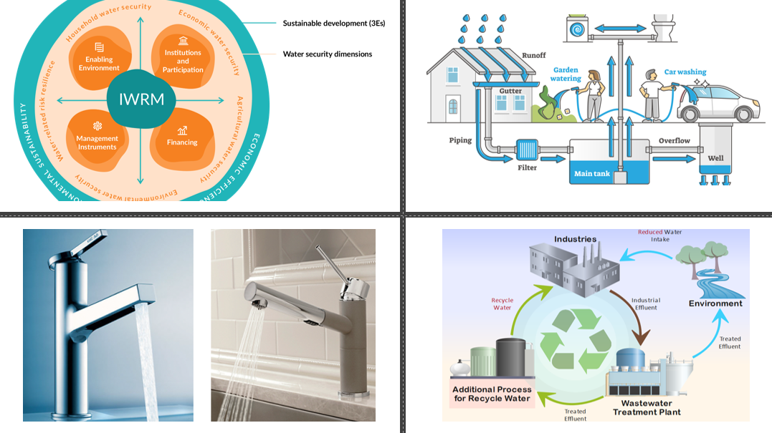
Water Conservation and Management
Water-efficient Tech: Use low-flow faucets, toilets, and water-saving appliances to reduce waste.
Rainwater Harvesting: Collect and store rainwater for irrigation, cleaning, and non-potable uses.
Wastewater Recycling: Reuse greywater and treated wastewater for industry, agriculture, and landscaping.
Integrated Water Resource Management (IWRM): Manage water resources holistically to balance social, economic, and environmental needs.
Source :
https://savethewater.org/rooftop-rainwater-harvesting-an-ancient-and-sustainable-technique-for-water-management/
Notes:
Image sources:
https://www.remodeling.hw.net/products/kitchen-bath/water-saving-products-whats-new-in-low-flow-faucets
https://savethewater.org/rooftop-rainwater-harvesting-an-ancient-and-sustainable-technique-for-water-management/
https://green.org/2024/01/30/the-economics-of-wastewater-reuse/
https://iwrmactionhub.org/about/iwrm-explained
Water Conservation and Management
Water-efficient Technologies: Installation of low-flow faucets, toilets, and water-efficient appliances (washing machines, dishwashers) to reduce water wastage.
Rainwater Harvesting: Collecting and storing rainwater for reuse in irrigation, cleaning, and other non-potable applications.
Wastewater Treatment and Reuse: Recycling greywater and treated wastewater for industrial, agricultural, and landscaping purposes.
Integrated Water Resource Management (IWRM): Holistic management of water resources that balances social, economic, and environmental objectives.
Examples:
Large-scale adoption of rainwater harvesting systems in urban areas or industries.
Government policies or community initiatives aimed at sustainable groundwater management.

Slide 18

Waste Management and Recycling
3Rs (Reduce, Reuse, Recycle): Minimize resource use, creatively reuse products, and recycle waste into new products.
Composting: Convert organic waste into nutrient-rich compost, reducing chemical fertilizer use.
E-Waste Recycling: Properly recycle electronics to recover materials and prevent environmental contamination.
Zero Waste: Cut landfill waste by redesigning processes, enhancing product durability, and maximizing recycling.
Source :
Image generated using AI tool
Notes:
Waste Management and Recycling
Reduce, Reuse, Recycle (3Rs): Encouraging minimal resource consumption (reduce), creative reuse of products (reuse), and processing waste materials into new products (recycle).
Composting and Organic Waste Management: Composting food and organic waste to create nutrient-rich soil additives that reduce the need for chemical fertilizers.
E-Waste Recycling: Managing electronic waste (old computers, phones, batteries) through proper recycling channels to recover valuable materials and prevent harmful chemicals from contaminating the environment.
Zero Waste Practices: Reducing waste to landfill by redesigning production processes, improving product durability, and maximizing recycling efforts.
Examples:
Municipal or corporate recycling programs.
Innovations in waste-to-energy systems that convert waste materials into electricity or fuel.

Slide 19
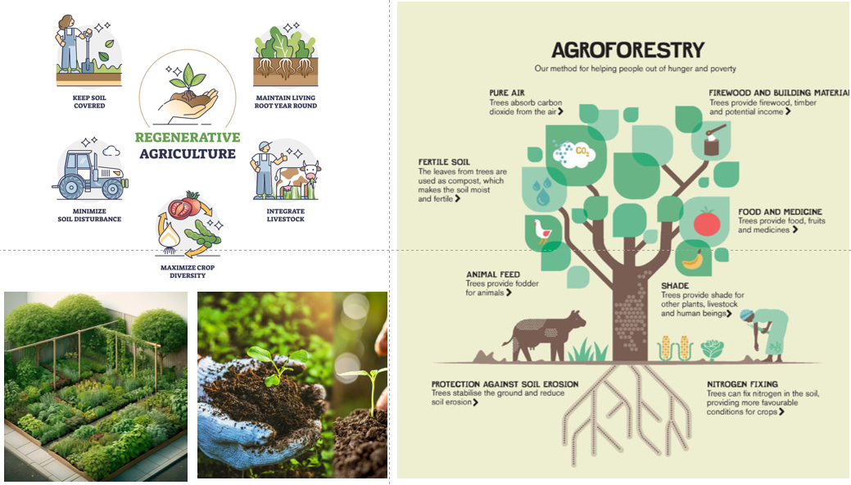
Sustainable Agriculture and Land Use
Permaculture: Create agricultural systems that mimic ecosystems, supporting biodiversity and soil health.
Regenerative Agriculture: Use farming methods that restore soil, boost biodiversity, and capture carbon.
Agroforestry: Integrate trees into farmland to improve biodiversity, soil stability, and resource efficiency.
Organic Farming: Use natural fertilizers, crop rotation, and pest control to sustain soil fertility.
Source :
https://www.moore-unidrill.com/what-is-regenerative-farming/
Notes:
Image sources:
https://www.moore-unidrill.com/what-is-regenerative-farming/
https://deepgreenpermaculture.com/permaculture/permaculture-design-principles/7-small-scale-intensive-systems/
https://viagroforestry.org/what-we-do/agroforestry/
https://www.khetivyapar.com/en/organic-farming-sustainable-organic-farming-50
Sustainable Agriculture and Land Use
Permaculture: Designing agricultural systems that mimic natural ecosystems, promoting biodiversity, soil health, and resource conservation.
Regenerative Agriculture: Farming techniques that restore soil health, increase biodiversity, and capture carbon to combat climate change.
Agroforestry: Integrating trees and shrubs into agricultural lands to enhance biodiversity, soil stability, and resource efficiency.
Organic Farming: Reducing chemical inputs by relying on natural fertilizers, crop rotation, and biological pest control to maintain long-term soil fertility.
Examples:
Organic farms employing regenerative practices to restore ecosystems while producing crops.
Governments or organizations providing incentives for sustainable farming practices.

Slide 20
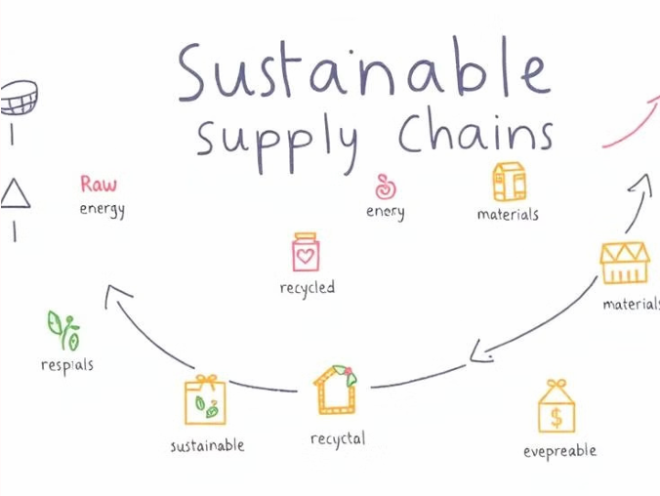
Sustainable Supply Chain Management
Ethical Sourcing: Source materials with minimal environmental impact and respect for human rights (e.g., fair trade).
Sustainable Procurement: Choose suppliers who prioritize sustainable practices in energy, waste, and labor.
Green Logistics: Minimize transport impact through route optimization, fuel efficiency, and eco-friendly packaging.
Source :
Image generated by AI tool
Notes:
Sustainable Supply Chain Management
Ethical Sourcing: Ensuring that raw materials and products are sourced in ways that minimize environmental impact and respect human rights (e.g., fair trade).
Sustainable Procurement: Favoring suppliers who prioritize sustainability in their operations, from energy use to waste management and labor practices.
Green Logistics: Reducing the environmental impact of transportation and distribution systems through route optimization, fuel efficiency, and eco-friendly packaging materials.
Examples:
Companies that have redesigned their supply chains to reduce their carbon footprint or water usage.
Brands sourcing materials from certified sustainable sources (e.g., FSC-certified wood).

Slide 21
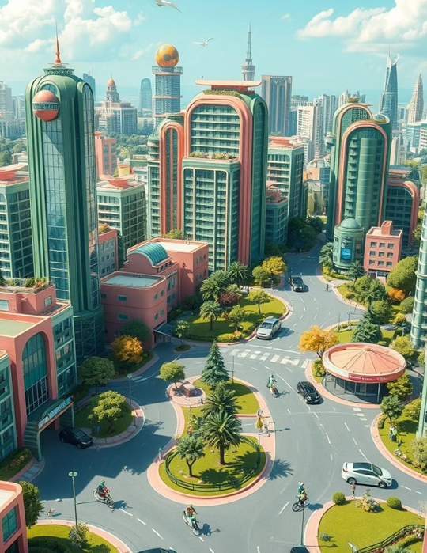
Sustainable Urban Planning and Development
Green Urban Spaces: Incorporate green roofs, parks, and gardens to improve air quality, biodiversity, and recreation.
Sustainable Transportation: Promote public transit, cycling, walking, and electric vehicles to cut carbon emissions.
Smart Cities: Leverage data and technology to optimize energy use, waste management, and transportation systems.
Source :
Image generated by AI tool
Notes:
Sustainable Urban Planning and Development
Green Urban Spaces: Designing cities with green roofs, parks, and community gardens to enhance air quality, support biodiversity, and provide spaces for recreation.
Sustainable Transportation Systems: Encouraging the use of public transport, cycling, walking, and electric vehicles to reduce urban carbon emissions.
Smart Cities: Using data and technology to improve the efficiency of resource management, from energy use in buildings to waste collection and transportation systems.
Examples:
Initiatives in cities like Copenhagen or Singapore where smart city concepts are integrated with sustainability goals.
Urban development projects prioritizing green infrastructure to manage stormwater, reduce heat islands, and improve residents’ quality of life.

Slide 22
Behavioral and Cultural Change for Sustainability
Education and Awareness Campaigns
Corporate Social Responsibility (CSR)
Community-led Initiatives
Promoting environmental literacy and resource conservation behaviors.
Companies adopting sustainability as a core value.
Grassroots movements encouraging sustainable lifestyles
Source :
https://www.linkedin.com/pulse/what-corporate-social-responsibility-csr-why-matters-govrncorp
Notes:
Behavioral and Cultural Change for Sustainability
Education and Awareness Campaigns: Promoting environmental literacy and resource conservation behaviors through campaigns in schools, workplaces, and communities.
Corporate Social Responsibility (CSR): Companies adopting sustainability as a core value, implementing green policies, and encouraging employees to participate in sustainability efforts.
Community-led Initiatives: Grassroots movements encouraging sustainable lifestyles, such as local clean-up drives, tree-planting events, or carpooling networks.
Examples:
Awareness campaigns targeting consumers to reduce single-use plastic.
Companies encouraging employees to adopt eco-friendly commuting or office practices.

Slide 23
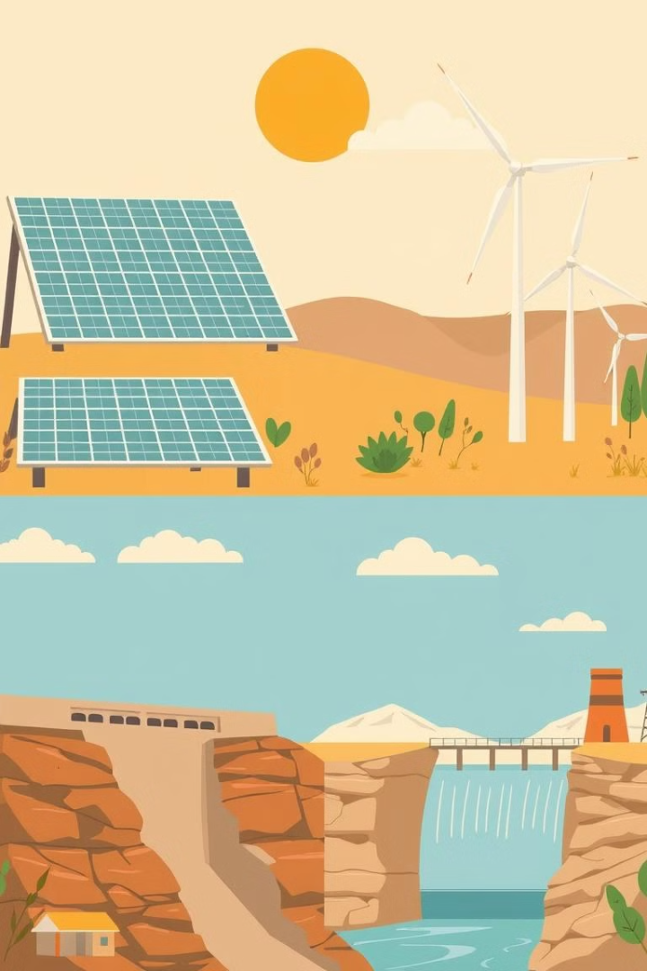
Green Technologies and Innovation
Green technologies are crucial for environmental sustainability and economic growth. They minimize negative impacts, promote efficiency, and reduce carbon footprints.
Renewable Energy Technologies:
Solar Power
PV panels convert sunlight into electricity.
Wind Energy
Wind turbines harness wind power.
Hydropower
Water turbines generate electricity.
Geothermal Energy
Heat from the Earth generates power.
Source :
Images are generated by AI tool
Notes:
Green Technologies and Innovation
Green technologies and innovations are essential for addressing environmental challenges while driving sustainable economic growth. These technologies minimize negative environmental impacts, promote resource efficiency, and offer innovative solutions for industries, governments, and individuals to reduce their carbon footprint.
Definition and Importance of Green Technologies
Green Technologies and Innovation refer to the development and application of environmentally friendly and sustainable technologies aimed at addressing environmental challenges like climate change, resource depletion, and pollution.
Green technologies help achieve sustainability goals by reducing carbon emissions, conserving natural resources, and promoting renewable energy sources.
Examples:
Adoption of solar panels and wind turbines for clean energy generation.
Development of electric vehicles (EVs) to reduce transportation-related emissions.
Renewable Energy Technologies
Solar Power: Photovoltaic (PV) panels convert sunlight into electricity, offering a renewable and abundant source of energy. Innovations in solar panel efficiency, storage solutions, and solar farms have driven the expansion of solar power worldwide.
Wind Energy: Wind turbines harness wind power to generate electricity. Offshore and onshore wind farms contribute significantly to renewable energy portfolios, with innovations focusing on improving turbine efficiency and integration into power grids.
Hydropower: Water turbines convert the kinetic energy of flowing water into electricity. Hydropower technologies focus on improving dam efficiency and developing low-impact, small-scale hydro projects that minimize environmental disruptions.
Geothermal Energy: Extracting heat from the Earth’s crust to generate electricity and provide direct heating solutions. Geothermal power plants are expanding, with innovations in drilling and resource identification improving access to this renewable energy source.
Biomass and Bioenergy: Biomass (organic material) is used to produce biofuels and bioenergy. Technologies like anaerobic digestion and biomass gasification provide renewable energy while reducing waste and promoting circular economy practices.

Slide 24
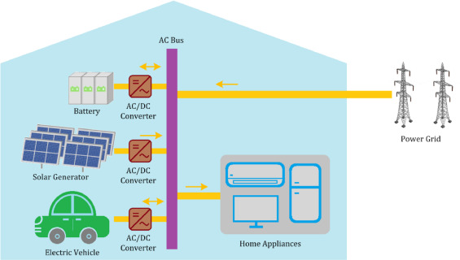
Green Technologies and Innovation
Energy Storage and Smart Grids:
Battery Technologies
Advancements in lithium-ion and solid-state batteries.
Smart Grids
Intelligent power distribution systems.
Energy Storage Systems
Large-scale storage for renewable energy
Source :
https://www.sciencedirect.com/science/article/abs/pii/S2352152X21003340
Notes:
Energy Storage and Smart Grids
Battery Technologies: Advancements in battery storage systems, such as lithium-ion and solid-state batteries, enable more efficient storage of renewable energy for use when the sun isn’t shining or the wind isn’t blowing. Innovations focus on improving energy density, reducing costs, and ensuring safety.
Smart Grids: Intelligent power distribution systems that optimize energy use by managing electricity demand, integrating renewable sources, and ensuring grid stability. Smart grids rely on data, sensors, and automation to enhance energy efficiency and reduce energy loss.
Energy Storage Systems (ESS): Large-scale storage systems (e.g., pumped hydro, thermal storage) allow excess renewable energy to be stored and used later, increasing the reliability of renewable energy supplies.
Examples:
Tesla Powerwall and other home energy storage solutions that enable households to store solar energy for later use.
Smart meters that monitor and optimize energy consumption in real time.

Slide 25
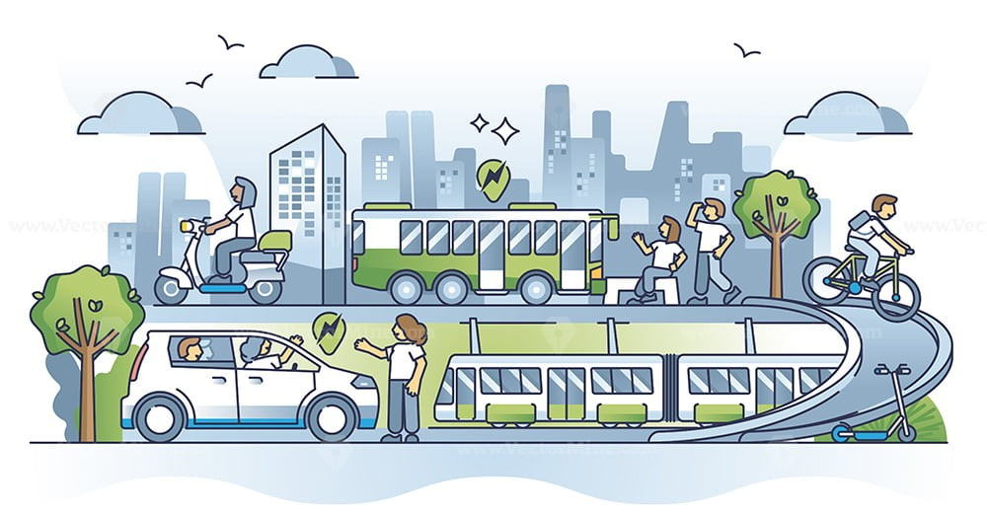
Green Technologies and Innovation
Green Transportation
Electric Vehicles
Reduce greenhouse gas emissions.
Hydrogen Fuel Cells
Produce electricity with water as byproduct.
Sustainable Aviation
Reduce air travel's carbon footprint
Source :
https://www.linkedin.com/pulse/advancing-sustainable-transportation-south-africa-pathway
Notes:
Green Transportation Technologies
Electric Vehicles (EVs): EVs are powered by electricity instead of fossil fuels, significantly reducing greenhouse gas emissions. Innovations in battery technology, charging infrastructure, and autonomous driving are driving the widespread adoption of EVs.
Hydrogen Fuel Cells: Hydrogen-powered fuel cells produce electricity through a chemical reaction, with water as the only byproduct. Fuel cell technology is being explored for transportation applications, especially in heavy-duty vehicles, buses, and long-haul trucks.
Sustainable Aviation: Electric and hybrid-electric aircraft, as well as sustainable aviation fuels (SAF), are reducing the carbon footprint of air travel. Innovations focus on improving fuel efficiency and developing alternative propulsion systems.
Shared Mobility and Smart Transportation: Car-sharing platforms, bike-sharing systems, and autonomous vehicles contribute to reducing traffic congestion, emissions, and the environmental impact of personal transportation.
Examples:
The rise of electric vehicles such as Tesla, Nissan Leaf, and Rivian, and their impact on reducing emissions.
Hydrogen-powered buses and trains being implemented in regions like Japan and Europe.

Slide 26
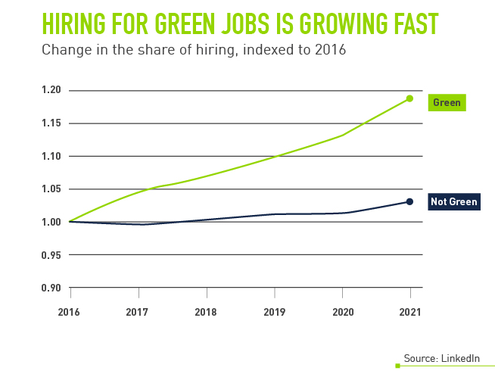
Green Jobs: A Growing Trend
The global economy is "greening," creating new jobs in sustainable sectors.
Demand:
Green skills job postings grew by 22.4% between 2022 and 2023.
Green talent in the workforce grew by 12.3% in the same period
Supply:
Source :
https://www.peoplescout.com/insights/green-jobs-green-skills-hiring-for-a-renewable-future
Notes:
Adaptation to Green Job Markets
The future of work is green. The United Nations says the world's global economy is "greening," as sectors like energy, transport, and construction become more sustainable. That process alone could create 24 million more jobs around the world by 2030, putting a premium on workers with green skills.
However, supply lags as demand spills into other areas, such as economics and finance, security, market and geopolitical analysis, communications, social sciences, and legal. According to the International Labor Organization, "green jobs reduce the consumption of energy and raw materials, limit greenhouse gas emissions, minimize waste and pollution, protect and restore ecosystems, and enable enterprises and communities to adapt to climate change.".
Demand for green skills far outpaces supply. According to LinkedIn's Global Green Skills Report, between 2022 and 2023, at least one job posting required a minimum number of green skills to grow by 22.4 percent while the share of green talent in the overall workforce only grew by 12.3 percent.

Slide 27

Government and Institutional Support
Programs promote environmental literacy and green skills.
Legislation
Environmental laws and regulations drive cleaner practices.
Funding
Incentives encourage investment in green technologies.
Education
Source :
https://theraise.eu/startup-news/navigating-government-funding-a-boost-for-startups/
Notes:
Government and Institutional Support
In any case, governments and institutions play a very important role in ensuring sustainability. Support for the green city idea can take many forms-including legislations, funding, researches and developments, public-private partnerships, and education initiatives.
Legislation and Policy Frameworks
Legislation and Policy Frameworks
Environmental Laws and Regulations: The policies determined by the government are decided upon by the laws enacted in various jurisdictions, creating standards for emission management, waste management, and resource conservation. This put companies into cleaner technology and practices.
Green Technology Incentives: Financial incentives such as tax credits, grants, and subsidies encourage businesses and individuals to invest in renewable energy, energy efficiency, and sustainable practices.
Building Codes and Standards: The government has set guidelines for building codes and energy efficiency standards to encourage the development of green buildings in new developments, so that the developments meet the criteria of sustainability.
Examples:
Clean Air Act and Clean Water Act are in place in the U.S. controlling the pollution level and keeping natural resources intact.
RPS set by the government, where utilities will have to generate a percentage of their supply from renewable sources.
Research and Development Funding
Innovations Green: Grants are usually offered by the government to research and universities for developing new technologies that solve environmental problems.
Cooperation of Government, Academic, and Private Sector: It provides cooperation that allows knowledge sharing and facilitates the commercialization of green technology.
Research Grants and Competitions: The funding through such programs encourages start-ups and researchers to look forward to a sustainable future by coming up with innovative ideas for greening.
Examples
Government grants on renewable energy research. Examples include grants by the U.S. Department of Energy.
Public-private partnerships that fund pilot projects on sustainable agriculture or clean energy technologies.
Public Awareness and Education Initiatives
Environmental Education Programs: State governments and institutions make environmental literacy to circulate at the school, university, and community levels through educational programs for building a green culture.
Awareness Campaigns for Taking up Sustainable Practices: Public campaigns create awareness among people and their organizations to take on sustainable practices, if only with overtly commercial goals.
Training and Certification Programs: Institutions provide professional training and certification programs in green technologies. Therefore, institutions prepare a skilled work force to meet the demands of the green economy.
Examples:
National programs focusing on education related to recycling and waste reduction, such as America Recycles Day.
Educational establishments incorporated sustainability into the curriculum

Slide 28
Examples of Government Support
Clean Air Act and Clean Water Act | Control pollution and protect natural resources.
Renewable Portfolio Standards (RPS) | Utilities must generate a percentage of their supply from renewable sources.
Government grants for renewable energy research | Support innovation and development of green technologies
Source :
www.freepik.com/
Notes:
1. Clean Air Act and Clean Water Act
The Clean Air Act (CAA) and the Clean Water Act (CWA) are two key pieces of environmental legislation in the United States designed to regulate and reduce pollution, improving air and water quality across the country.
Clean Air Act (CAA):
First passed in 1963, with major amendments in 1970, 1977, and 1990.
To control air pollution on a national level and protect public health and the environment from harmful airborne contaminants. It regulates emissions from industries, motor vehicles, and other sources.
Key Provisions:
Establishment of the National Ambient Air Quality Standards (NAAQS) for harmful pollutants like ozone, sulfur dioxide, nitrogen dioxide, and particulate matter.
Authority to the Environmental Protection Agency (EPA) to regulate air pollutants and set emission standards.
Programs to reduce acid rain, toxic air pollutants, and depletion of the ozone layer.
Significance: The CAA has been instrumental in reducing air pollution, improving public health by preventing thousands of premature deaths, and addressing climate change by limiting greenhouse gas emissions from various sources.
Clean Water Act (CWA):
Originally passed as the Federal Water Pollution Control Act in 1948, with significant amendments in 1972 that became known as the Clean Water Act.
To regulate the discharge of pollutants into U.S. waters and maintain water quality for the protection of aquatic ecosystems, drinking water sources, and recreational waters.
Key Provisions:
Establishment of the National Pollutant Discharge Elimination System (NPDES), which requires permits for any discharge of pollutants into waters of the United States.
Setting of water quality standards for surface waters.
Protection of wetlands through regulatory permitting.
Significance: The CWA has led to significant improvements in water quality, reduction in pollution, and increased enforcement to maintain the health of rivers, lakes, and coastal waters.
2. Renewable Portfolio Standards (RPS)
Renewable Portfolio Standards (RPS) are state-level policies designed to increase the generation of electricity from renewable energy sources. These policies mandate that a certain percentage of electricity sold by utilities must come from renewable energy like wind, solar, geothermal, and biomass.
How It Works:
An RPS sets a target, such as 20% of electricity generation from renewable sources by a specific year.
Utilities must either generate renewable energy or purchase Renewable Energy Certificates (RECs) from other producers to meet the targets.
Penalties are imposed on utilities that fail to meet their RPS obligations.
Significance:
Encourages the transition from fossil fuels to cleaner energy sources, helping reduce greenhouse gas emissions and dependence on non-renewable resources.
Stimulates investment in renewable energy infrastructure, driving innovation and job creation in the clean energy sector.
RPS policies have been adopted in over 30 U.S. states and territories, with some states setting ambitious goals for 100% renewable energy in the coming decades.
Example: California's RPS requires that 60% of electricity retail sales come from renewable sources by 2030, with a goal to reach 100% clean electricity by 2045.
3. Government Grants for Renewable Energy Research
Government grants for renewable energy research are funds provided by federal, state, or local governments to support the development of new technologies and solutions in the renewable energy sector.
Purpose:
To advance the research and development (R&D) of innovative renewable energy technologies such as solar panels, wind turbines, energy storage, hydrogen fuel cells, and bioenergy.
To make renewable energy more affordable, efficient, and scalable, enabling a transition to a low-carbon economy.
Key Programs:
Department of Energy (DOE): The U.S. DOE is a major provider of renewable energy grants through initiatives like the Office of Energy Efficiency and Renewable Energy (EERE), which funds projects in solar, wind, geothermal, hydropower, and energy storage technologies.
Advanced Research Projects Agency-Energy (ARPA-E): A program that supports high-risk, high-reward research projects aimed at developing transformational energy technologies that are too early-stage for private sector investment.
State and Local Initiatives: Many states offer grants and incentives to local businesses, universities, and research institutions for renewable energy projects.
Significance:
Government funding has been crucial in lowering the costs of renewable technologies, improving their efficiency, and facilitating widespread adoption.
Grants support early-stage innovations that may otherwise lack the necessary financial backing, accelerating the commercialization of cutting-edge solutions.
These efforts contribute to meeting national and global climate goals, reducing carbon emissions, and mitigating the impacts of climate change.
Examples of Impact:
The dramatic decline in the cost of solar panels and wind turbines over the past decade is partially attributable to government-backed research and development.
Breakthroughs in battery storage technology, funded through public grants, are enabling more reliable integration of renewable energy into the grid.
Together, these programs and regulations have been vital in shaping the U.S. energy landscape, promoting clean energy, and protecting public health and the environment.

Slide 29

Role of Education and Training Institutions
Integrating Sustainability into Curriculum:
Cross-Disciplinary Approach: Embed sustainability in primary, secondary, and tertiary education across various subjects (STEM, arts, economics).
Awareness Programs: Initiatives like workshops and eco-friendly campaigns foster environmental consciousness among students.
Focus on Key Areas
STEM Education: Essential for developing skills in renewable energy, sustainable agriculture, and environmental conservation.
Source :
https://www.learningroutes.in/blog/role-of-education-in-promoting-sustainability
Notes:
Role of Education and Training Institutions
Amidst the nature of climate change, environmental degradation, and the ultimate shift to a sustainable economy, significant institutions of education and training must focus on supporting the development of the workforce for "green skills." These represent the knowledge, abilities, values, and attitudes required to support sustainability and environmental stewardship in different sectors.
Here a look into how educational and training institutions contribute to green skilling and sustainability:
Contribution of Educational and Training Institutions to Green Skilling and Sustainability
Curriculum Integration and Green Education
Sustainability can be included in the curriculum of institutions at all levels: primary, secondary, and tertiary. This enables children to learn about environmental education integrated within various subjects- including science and engineering, economics, and the arts. Through this mechanism, educational institutions can make students aware of global environmental challenges, their causes and possible solutions.
Focus: Science, technology, engineering, and mathematics (STEM) subjects are critical to developing some key skills in green sectors like renewable energy, sustainable agriculture, and environmental conservation.
Multidisciplinary Approach: Sustainability concepts applied across disciplines result in holistic learning for the students who learn what goes along in an interdependent relationship with the overall systems of environment, society, and economy.
Awareness About Environmental: An awareness program on environmental issues can be set up by the school and colleges as part of their endeavour. Workshops, campaigns, or a green initiative like planting trees, recycling, and so on can be undertaken in both schools and colleges to instil sustainable behaviours among its students.

Slide 30

Role of Education and Training Institutions (Contd.)
Vocational Training for Green Jobs
Skill Development: Technical institutes provide hands-on training in fields like renewable energy, waste management, and sustainable construction.
Examples of Skills: Courses in solar panel installation, wind energy maintenance, and sustainable agriculture practices.
Research and Innovation
Green Technologies: Universities lead research in energy-efficient technologies and sustainable practices, driving innovation in green sectors.
Sustainable Business Models: Educational programs help design sustainable business practices that support circular economy initiatives.
Source :
https://www.iiteducation.in/vocational-education.html
Notes:
Vocational Training and Green Jobs
Most importantly, vocational and technical institutes provide people with the training necessary for green occupations, especially in renewable energy, waste management, water conservation, and sustainable construction. The emergence of a green economy demands such skilled labour for these needs.
Some of the examples of vocational skills needed in green industries include: courses in solar panel installation and wind energy maintenance, as well as bioenergy production.
Sustainable Agriculture: The education imparts related training to ensure productivity by minimizing negative impacts on their environment through sustainable agriculture, organic farming, and agroforestry.
Circular Economy Skills: Reuse and recycling, upcycling, and waste-to-wealth methods of jobs skills for working in waste management and circular economy jobs.
Research and Innovation
Universities and research institutions are innovators in green technologies and practices. They play a part in making solutions which make energy efficiency, pollute lesser and create biodiversity through research and development.
Research into Green Technologies: Universities are involved in research on energy-efficient technologies, electric vehicles, sustainable building materials, and climate-resilient infrastructure which brings innovation in support of sustainability.
Sustainable Business Models: Business schools and entrepreneurship programs can guide the students to design and operate sustainable businesses that develop circular economy models and conduct ethical business practices.

Slide 31

Role of Education and Training Institutions (Contd.)
Community Engagement Initiatives
Public Outreach Programs: Educational institutions conduct local environment clean-up drives and workshops on sustainable living.
NGO and Government Partnerships: Collaborate with external organizations to implement and scale green initiatives at the community level.
Preparing a Green Workforce
Green Skills in Core Education: Ensure all students receive training in sustainability, regardless of their field of study.
Apprenticeships and Practical Experience: Partnerships with green businesses provide students with real-world experience in renewable energy and environmental conservation.
Source :
https://www.edc.org/edc-leads-national-convening-preparing-green-and-blue-workforce
Notes:
Community Engagement and Awareness
One of the major drivers of community-based sustainability initiatives occurs through the campus of educational and training institutions. Such institutions, in partnership with local communities, can nurture greener and environmentally friendlier practices and action both on and off campus.
Public Outreach Programs: Universities and schools can lead the way in community programs for climate change awareness drives, local environment clean-up drives, or even workshops about sustainable living such as conserved water use practices and energy saving.
NGO-Government Partnerships: Collaborate with the government and NGOs to scale green initiatives. Develop policies that enhance sustainability from the grassroot level.
Building a Green Workforce
The institutions drive to ensure the graduates enter the workforce and support the establishment of a sustainable economy.
This is achieved through:
In-embedding Green Skills in Core Subjects: In order to ensure that all students are educated on environmental and sustainability modules in all sorts of courses, whether business and engineering and law, their graduates are never going to lack any kind of basic sustainability knowledge.
Apprenticeship and Practical Exposure: Tying up with green businesses and sustainability-driven organizations and governmental bodies can provide students with strong apprenticeships and practical exposure to initiatives in fields such as renewable energy, sustainable design, and environmental conservation.

Slide 32

Case Study
Skill Council for Green Jobs (SCGJ)
Swachh Bharat Mission (Waste Management)

Slide 33

Conclusion
The presentation highlights the critical role of green skilling in achieving a sustainable future.
Through environmental awareness and literacy, individuals and organizations can make informed decisions that reduce their ecological and carbon footprints.
By integrating sustainable practices into various sectors such as energy, agriculture, and urban planning and leveraging green technologies, we can address global challenges like climate change while fostering economic growth.
The collective effort of governments, institutions, and communities is essential to ensuring that we meet the needs of the present without compromising the ability of future generations to meet theirs.
Source :
www.freepik.com/

Slide 34
References
https://www.weforum.org/agenda/2024/02/green-jobs-green-skills-growth/
https://www.british-assessment.co.uk/what-is-sustainable-resource-management-and-how-do-you-achieve-it/
https://www.investopedia.com/terms/g/green_tech.asp
https://www.doe.virginia.gov/teaching-learning-assessment/instruction/environmental-literacy
https://earth.org/climate-change/
https://earth.org/environmental-education/
https://www.britannica.com/topic/environmental-policy/Global-policy-agreements

Slide 35


Let’s Start

Slide 36


Quiz
Which of the following is a key component of environmental literacy?
a) Knowledge of technological advancements
b) Awareness and sensitivity to environmental problems
c) Ability to calculate personal finances
d) Understanding global financial systems
Answer: b
Awareness and sensitivity to environmental problems

Slide 37
Quiz
2. What is an ecological footprint?
a) The total amount of carbon emissions produced
b) The amount of biologically productive land and water needed to support one’s lifestyle
c) The distance a person travels to work
d) The sum of waste produced by a community
Answer: b
The amount of biologically productive land and water needed to support one’s lifestyle

Slide 38
Quiz
3. What are the three pillars of sustainability?
a) Environmental sustainability, economic sustainability, social sustainability
b) Financial sustainability, energy sustainability, social stability
c) Government policies, technological development, energy use
d) Climate change, population control, resource management
Answer: a
Environmental sustainability, economic sustainability, social sustainability

Slide 39
Quiz
4. Why is sustainability important?
a) To maximize short-term profits
b) To promote responsible use of natural resources and ensure the well-being of future generations
c) To avoid global financial crises
d) To create competition among businesses
Answer: b
To promote responsible use of natural resources and ensure the well-being of future generations

Slide 40
Quiz
5. How can community engagement help enhance environmental awareness?
a) By focusing only on waste management
b) Through increased industrial growth
c) By ignoring government policies
d) Through workshops, clean-up projects, and sustainability initiatives
Answer: d
Through workshops, clean-up projects, and sustainability initiatives

Slide 41
Thank You
Notes:
Thank You !!

